Slide 1
WEEK 5 PROGRESS REPORT
EUNICE ORENGE
LABAN MWANGI
VICTOR NGATIA
STEPHEN KINUTHIA

Slide 2
The week’s TASKS
DESIGN OF BUCK CONVERTER CIRCUIT
CONTROLLER PURCHASE RESEARCH

Slide 3
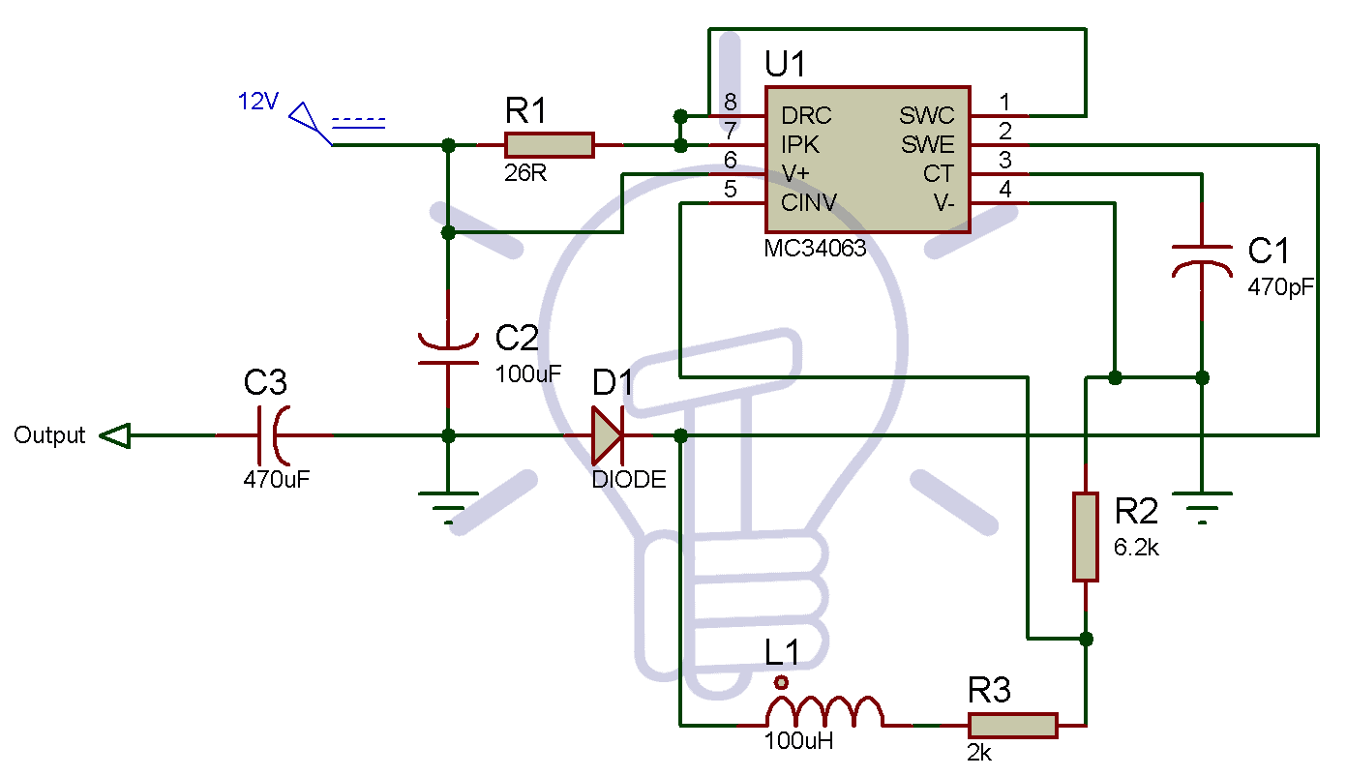
BUCK CONVERTER DESIGN
12V-5V BUCK CONVERTER CIRCUIT
Circuit Diagram

Slide 4
Cost of design
Inverting regulator IC –MC38063-300/=
Inductor 100µH – 120/=
Resistors -26-100/=
6.2k-100/=
2k- 100/=
Capacitors
100µF-100/=
470pF-100/=
470µF-100/=
Diode 70/=
Total cost of design 790/=

Slide 5
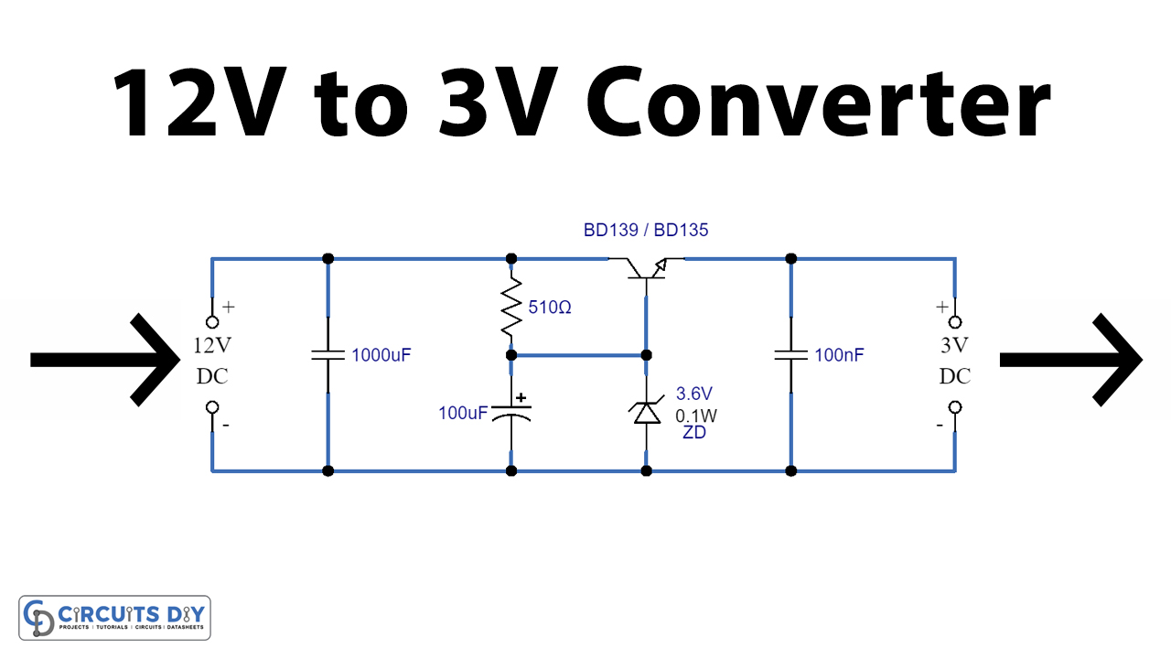
BUCK CONVERTER DESIGN
12V-3V BUCK CONVERTER CIRCUIT
Circuit Diagram

Slide 6
Cost of design
Capacitors
-1000µF-100/=
-100nF- 100/=
-100µF
Resistor 510 Ω-100/=
Zener Diode 3.6V 0.1 W - 120/=
BD139 NPN transistor -200/=
Total design cost 620/=

Slide 7
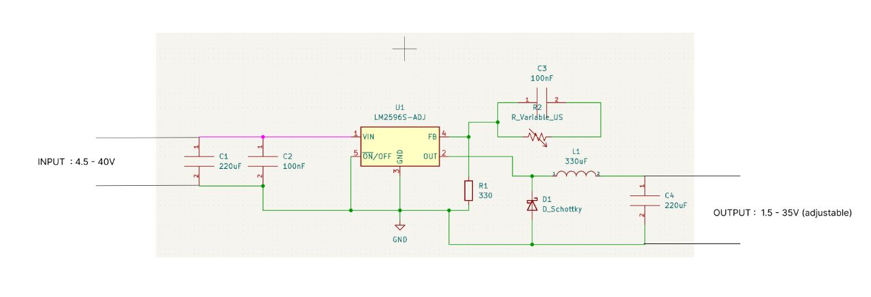
CIRCUIT DIAGRAM DESIGNED

Slide 8
COMPARISON
It is relatively cheaper to buy the converters than it is to fabricate the circuit design, but the team would be up to the challenge of the fabrication.

Slide 9
Controller purchase
1. KELLY MOTOR CONTROLLER
MODEL NUMBER:KAC96501-8080N
COMPANY NAME: KELLY CONTROLLERS
Price range- 499 – 599 USD
Electric Pedal Price Range : 25-79 USD
Reference : https://kellycontroller.com/shop/kac-8080n/

Slide 10
CONTROLLER PURCHACE
2. CUTRIS MOTOR CONTROLLER
MODEL NUMBER : CUTRIS 1238E/1239E
COMPANY NAME: CURTIS INSTRUMENTS
PRICE RANGE: 263,000/= Ksh.

Slide 11
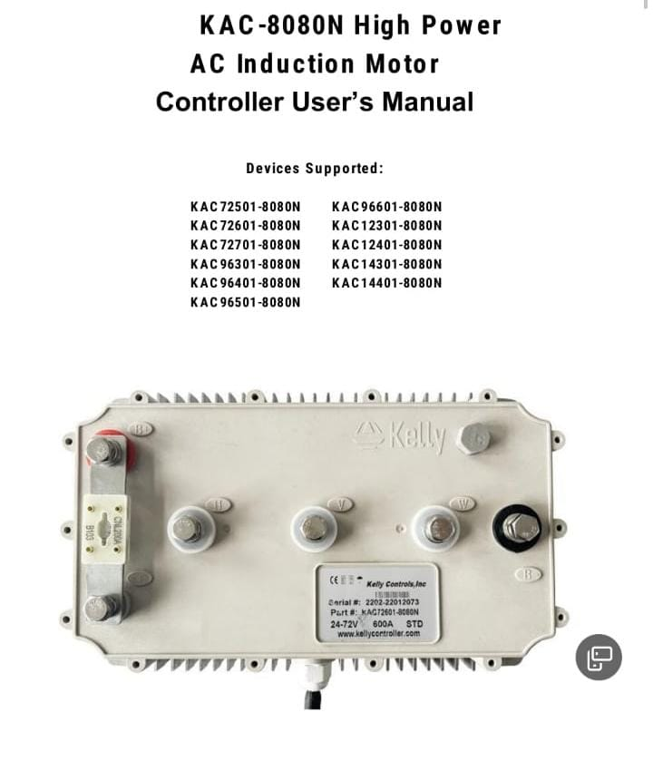
Kelly controller

Slide 12
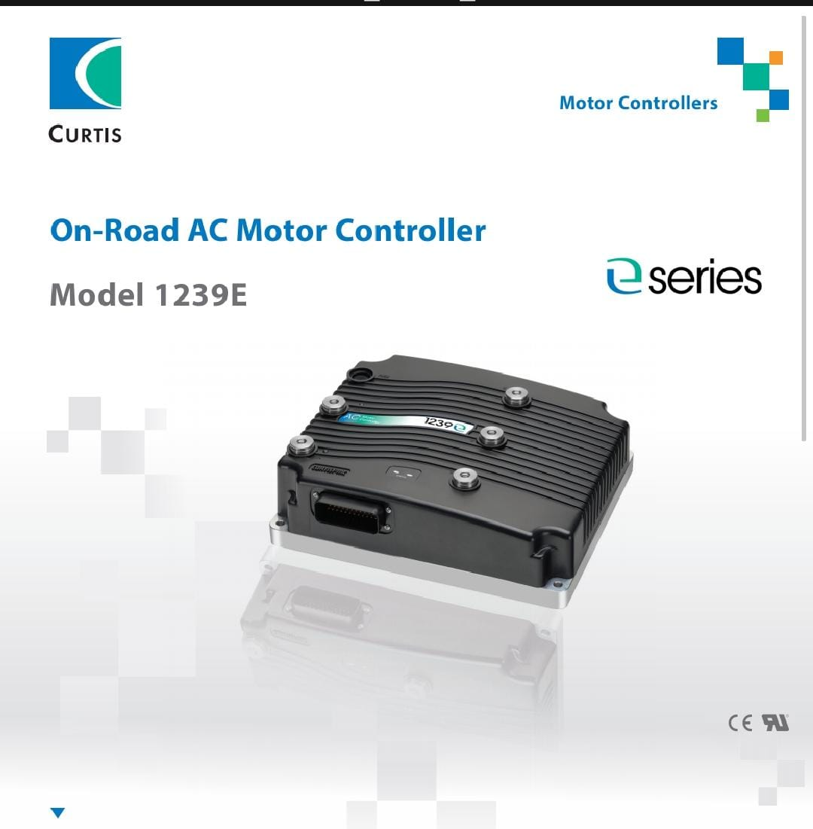
Curtis controller

